Slide 2
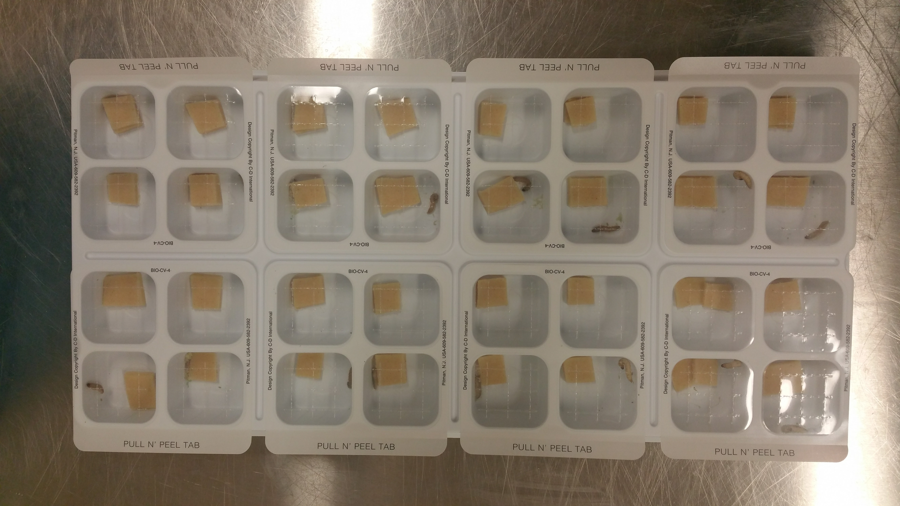
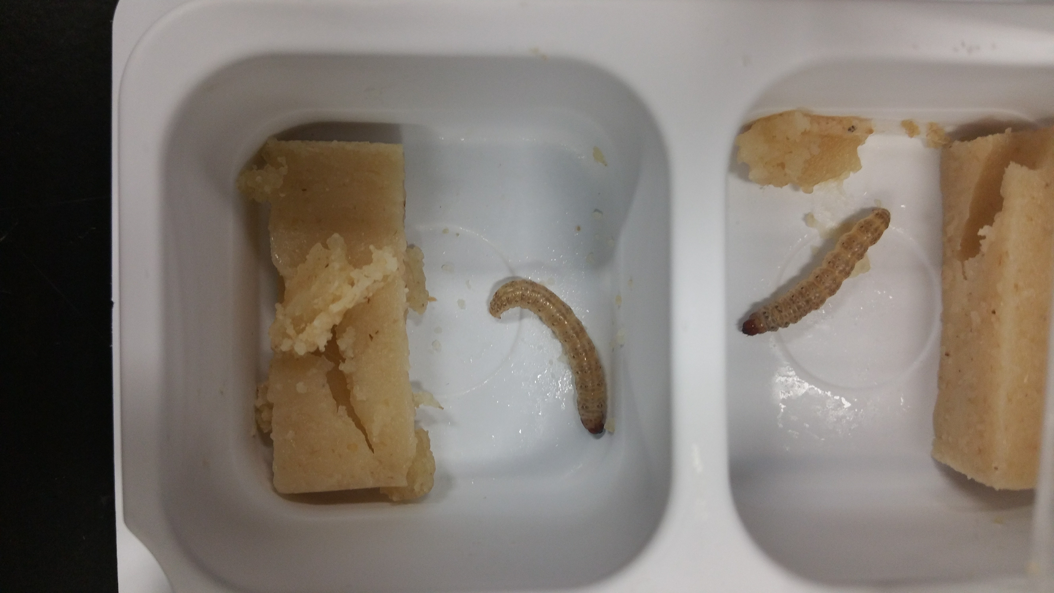
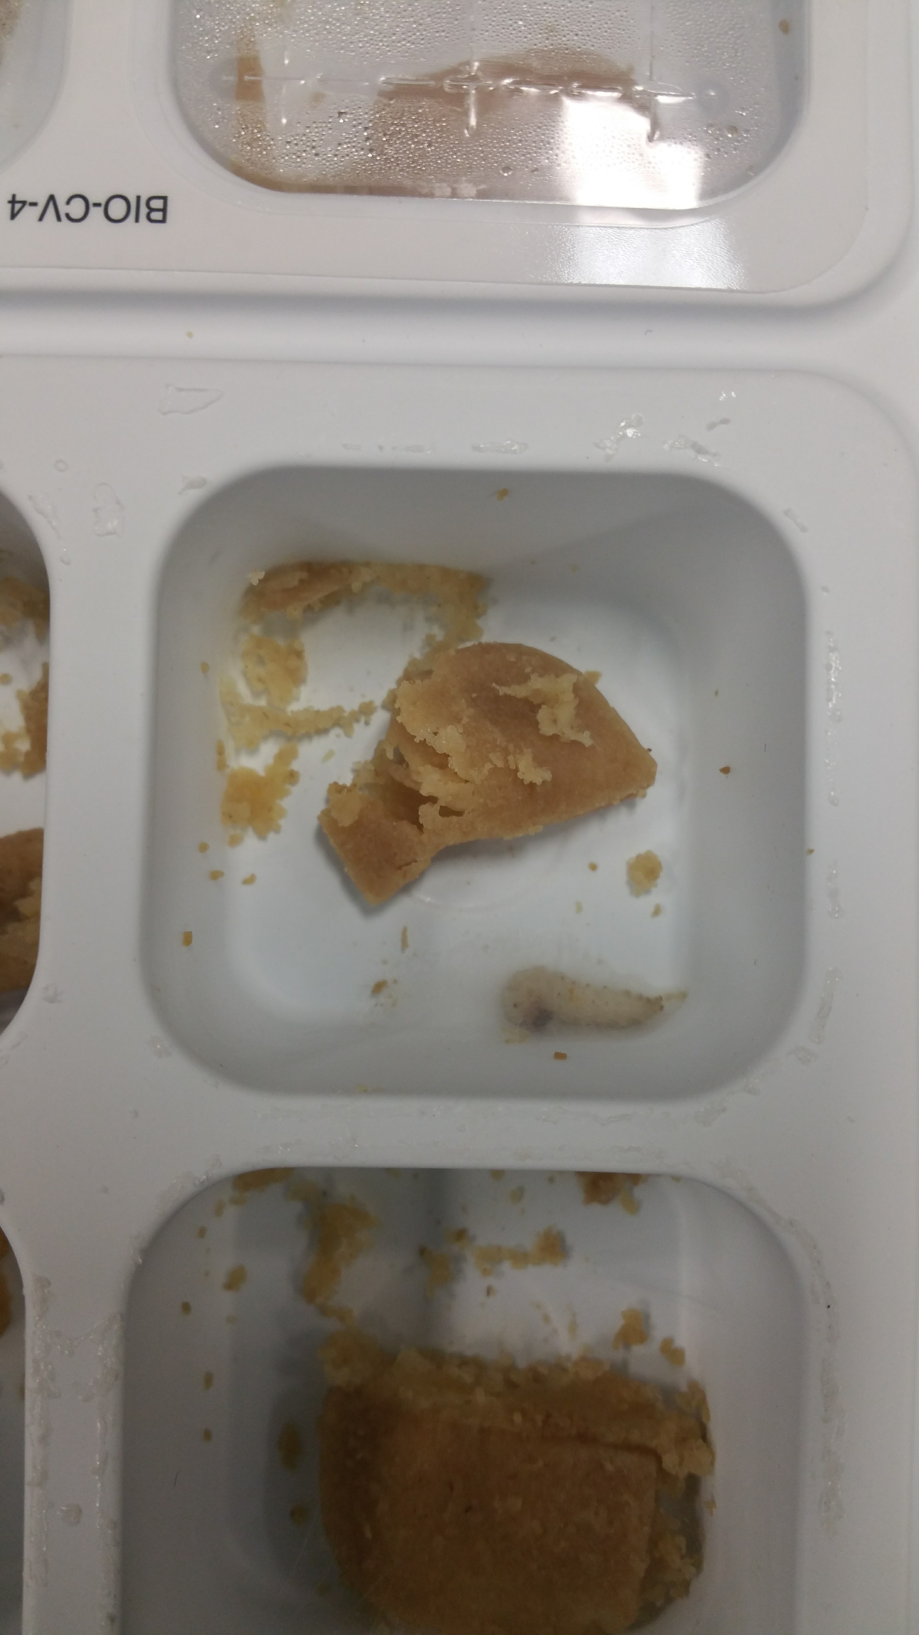
Wandering Larvae
Colony reared in mass until 5th instar
Diet pushed until “wandering"
Larvae voluntarily separate from diet
Diet Pushed
Web Gallery

Slide 3
Drying Whole Larvae
Random sample of 10 larvae
Weighed throughout lyophilizing process to track water loss
Approx 3.5% weight loss from water.

Slide 4
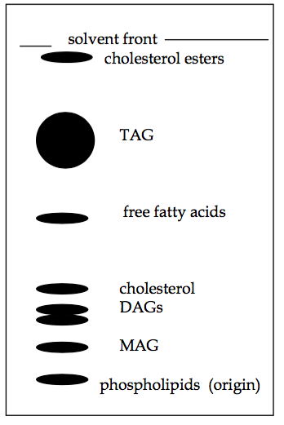
Tissue pulverized in a bilayer solvent mixture
Solvent Tissue Rinses
Standard
1
2
3
4
5
6
Standard

Slide 5
END

Slide 6
Characterizing Proteins
Larva Sample
Notes:
Quantification
HPLC-ELSD to quantify TAG in larval samples
Identification
GC-FID to identify methylated TAG samples

Slide 7

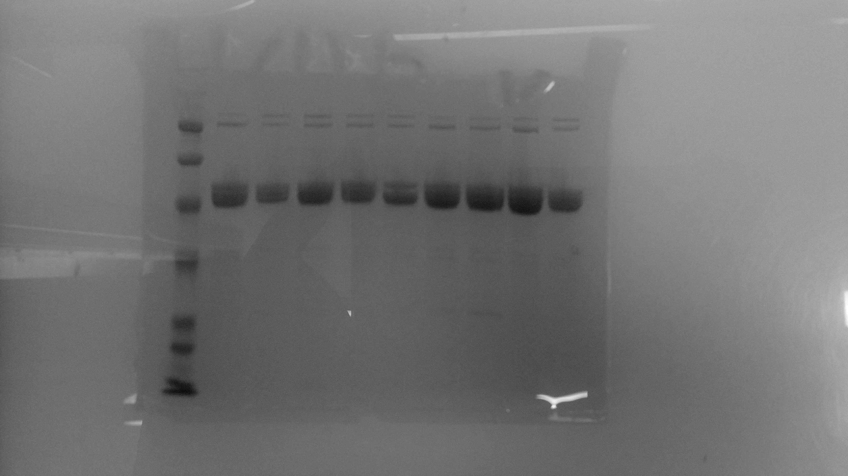
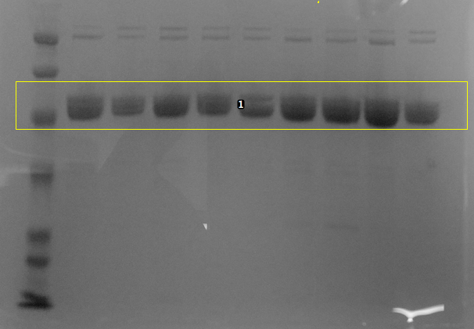
Quantify Storage Protein
Ladder
Larva
SDS-PAGE Gels loaded with extracted larval protein
Densitometry comparison of total protein

Slide 8


Identify Storage Protein
Ladder
Larva
Extracted protein sequenced by ICBR
Sequenced proteins compared to related species identity using NCBI
Sequenced proteins compared to ECB Expressed Sequence Tag (EST) database using NCBI

Slide 9
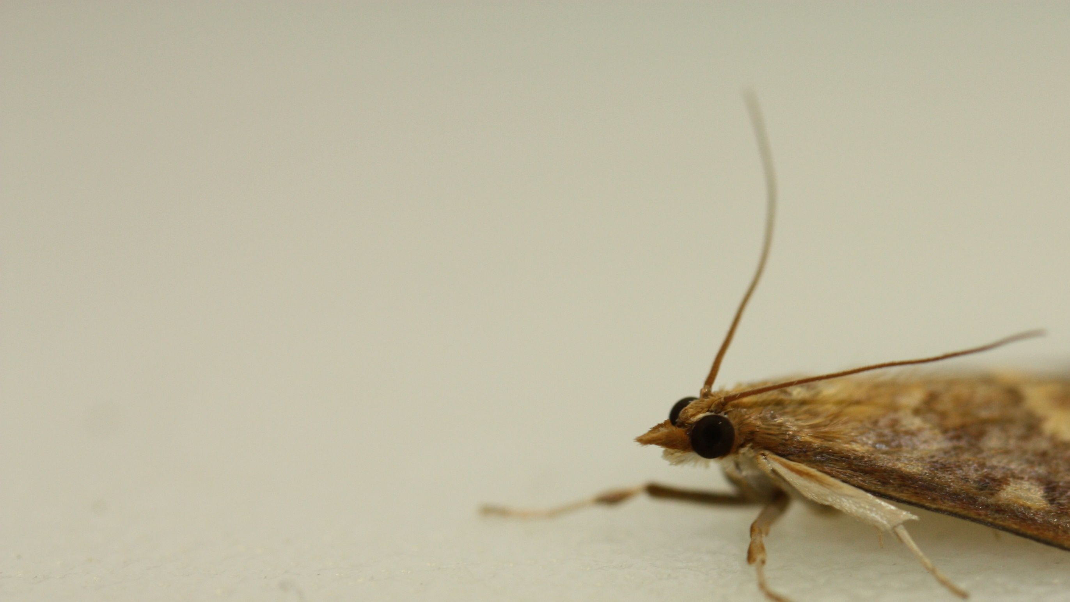
IPM Strategy
Reduced synchrony with environment leading to ecological suicide
Linking energy state to diapause
Finding the minimum energy required to survive diapause
Notes:
Take the information about the character of the energy state of ECB and chase this concept of minimal energy required to survive diapause and work to characterize that energy state….Does it look something like this graph on this slide where percent survival gradually decreases as “diapause energy” is reduced?

Slide 10
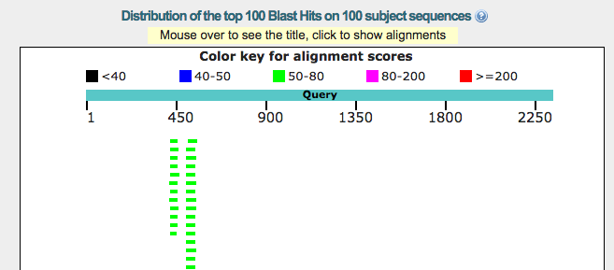
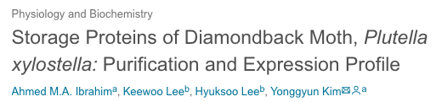
Preliminary Data: ICBR and NCBI Results
ICBR Protein Fragment Comparison with M. sexta
Blast M. sexta protein against ECB ESTs
EST sequences can be used to produce antibodies or find antibodies
SRA:SRR2316042.7475261.1 SRA:SRR2316035.15546889.1 SRA:SRR2316035.14894721.1 SRA:SRR2316035.12536223.1 SRA:SRR2316035.8237290.1 SRA:SRR2316035.6708150.1 | SRA:SRR2316035.4511466.1 SRA:SRR2316035.812153.1 SRA:SRR2316033.22499502.1 SRA:SRR2316033.14209029.1 SRA:SRR2316035.20150581.1 SRA:SRR2315298.5395625.1

Slide 11
Interactions
Climate
Pests
Diapause

Slide 12
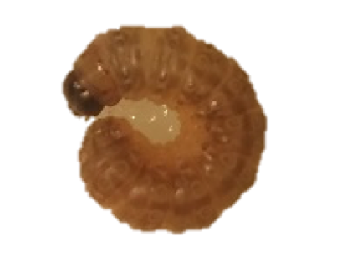
Summer Growing Season | Cool Fall Season
Eggs
Larva
Pupa
Adult
Eggs
Adult
Larva

